Slide 1
rBHOO General Meeting
February 14, 2024

Slide 2
Agenda – Call to Order
Meeting will begin promptly at 7pm
www.rbhoo.org

Slide 3
All Zoom Participants are muted!
Enter questions into the chat
or
Text questions to 859-743-0451
Pictures might be taken and possibly used on the RBHOO website.

Slide 4
Pledge of Allegiance
www.rbhoo.org

Slide 5
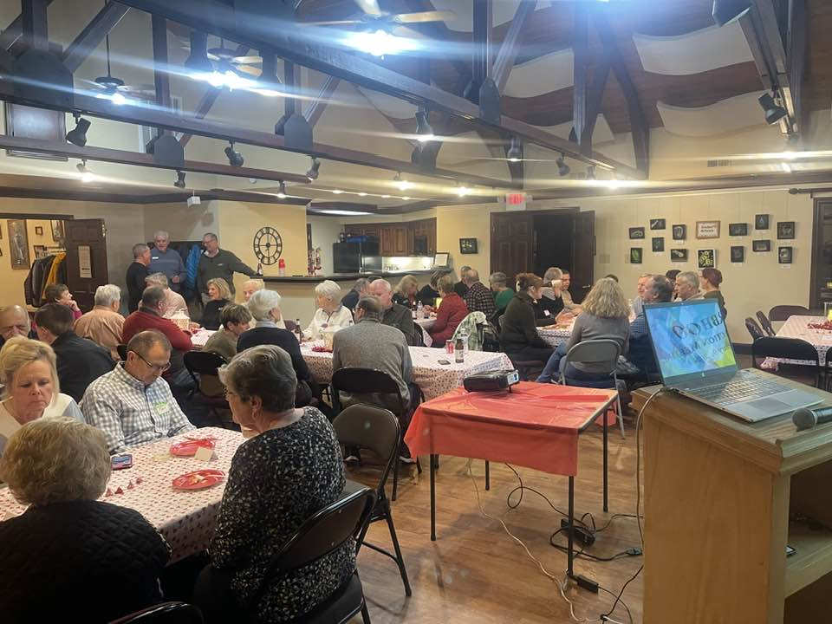
Big Thank You to You!
The Kats
(Cathy Garrett/Kathy Kachelmeyer)
Organizing the RBHOO
Meet & Greet For New Residents

Slide 6
Happy Valentines Day!

Slide 7
Save the Date – Friday April 26th!
Hosted by the RBCAI
Many Sponsors
RBCAI Board of Directors
Clubs (Women’s, RBHOO, Pickleball)
Builders
Realtors
Tradesman
Residents (current and past)
Tickets cost $50/person
Open to current and past residents
Sponsors
Details to be sent February 15

Slide 8
Agenda
Old Business
Community/Education Presentations
New Business
Upcoming Events
www.rbhoo.org

Slide 9
Old Business
Secretary Report
Zoom meeting is on www.rbhoo.org.
No written minutes were taken; nothing to approve, Zoom meeting is the minutes.
Membership Report
2024 Membership Goal 200
2024 Membership 187
32 New Members
7 Old Members (prior to 2023)
www.rbhoo.org

Slide 10
Old Business
Treasurer Report
Beginning Balance (12/31) $ 7055
Dues $ 1385
Other Income: $ 0
Expenses $ 1676
$97 - Storage Unit (2 months)
$579 – X-mas party
$1000 – 30th Celebration
Current Balance (1/31) $6764
Outstanding Liabilities $250
$250 – Membership Drive
Outstanding Deposits $260 (dues)
www.rbhoo.org

Slide 11
Presentation -
Lost Vets Rescue
Willie Franklin - Founder
www.rbhoo.org

Slide 12
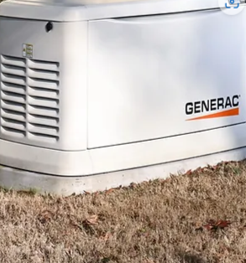
Presentation -
Backup Generators
Luke Dalton, McCay Southern
www.rbhoo.org

Slide 13
Where does power come from?

Slide 15
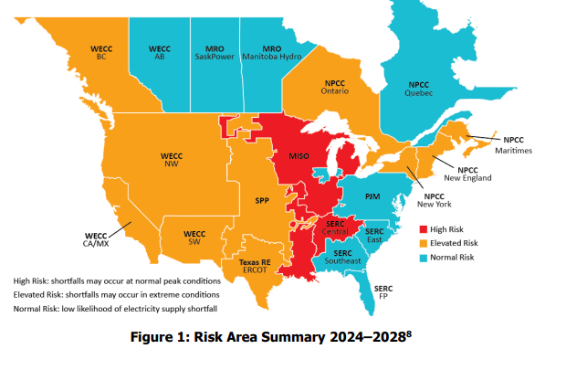

Slide 16
How is Tennessee electricity created?

Slide 17
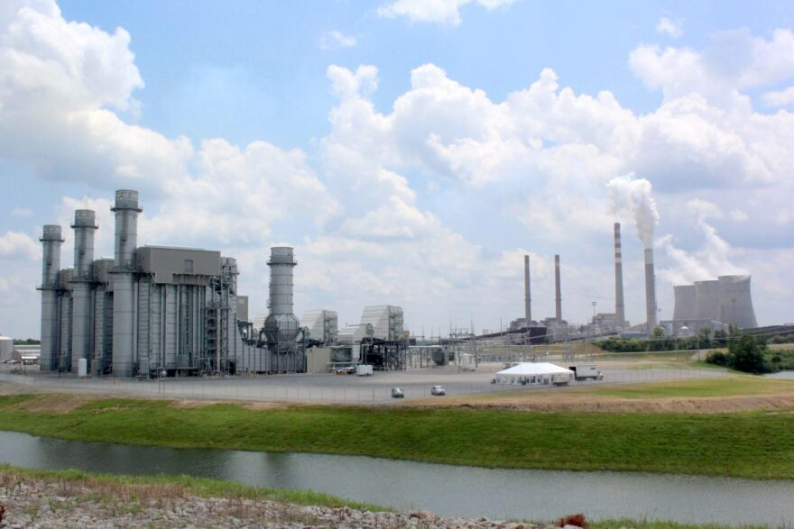
Nuclear
Coal
Hydroelectric
Natural Gas

Slide 18
(As of 2022)
TVA facilities
3 Nuclear plants
8 natural gas-fired plants
4 coal-fired plants
29 Hydro Plants
1 wind farm
13 solar power facilities

Slide 19
Where does it come from?

Slide 20
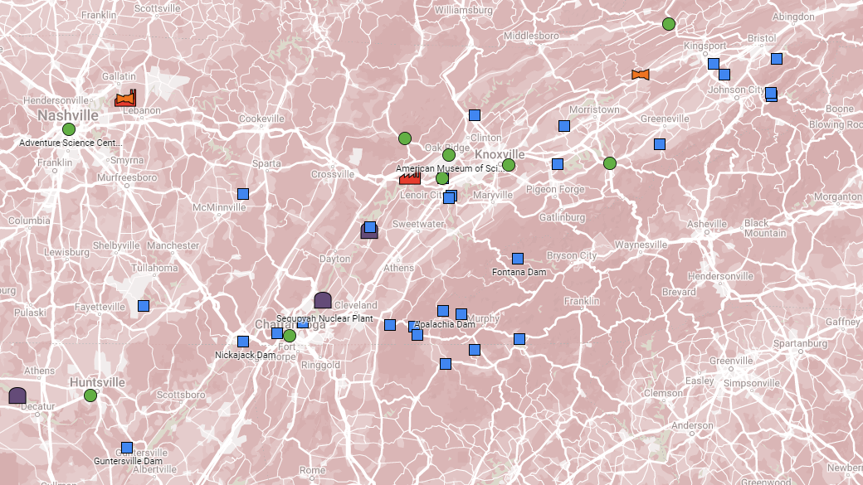
Natural Gas
Hydroelectric
Nuclear
Coal
Renewable (wind or solar)

Slide 21
How does it get to me?

Slide 23
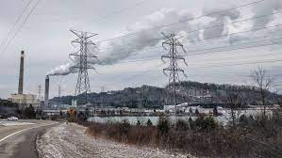
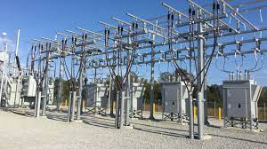
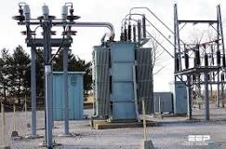
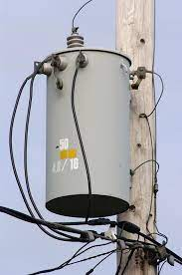
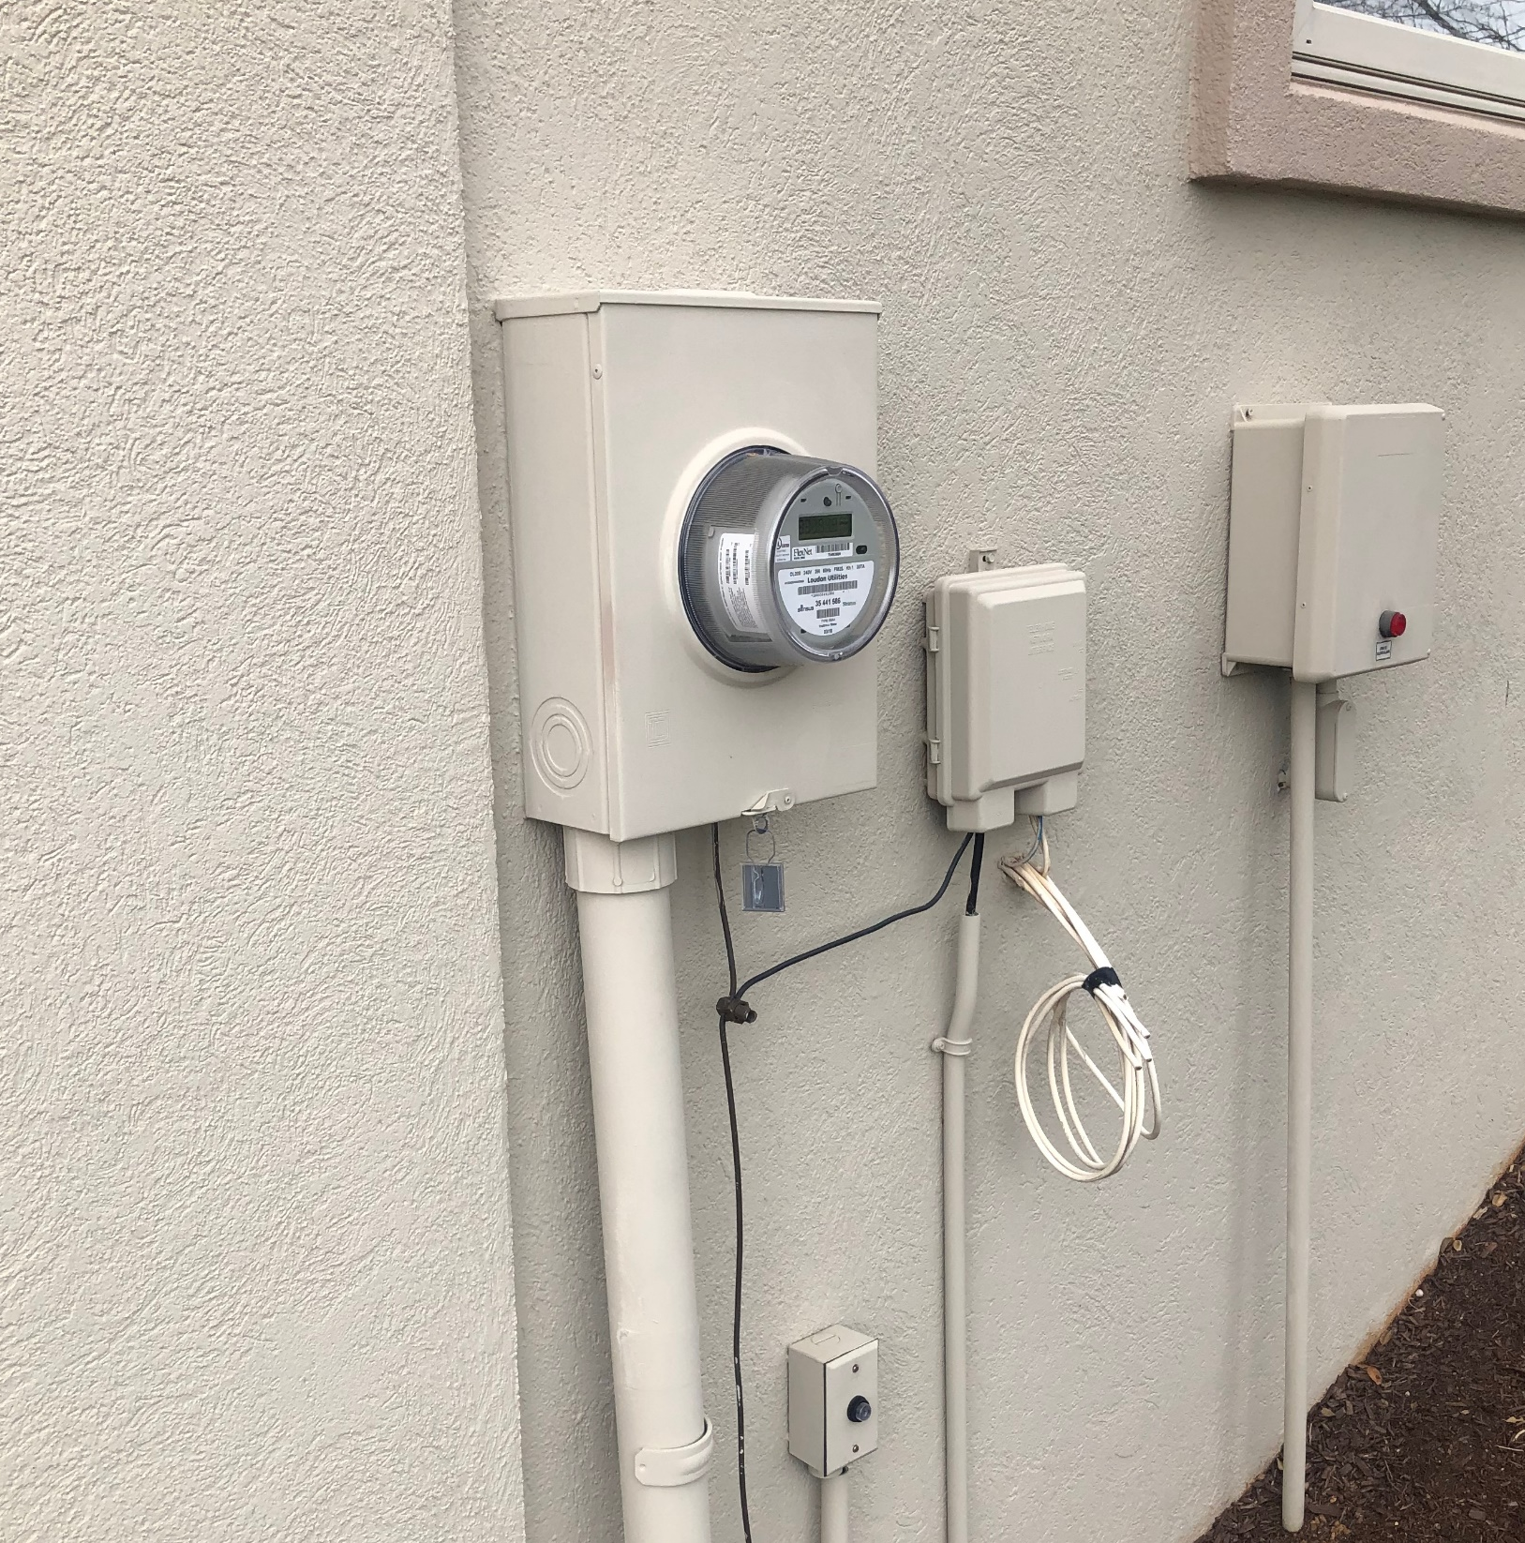
Transmission Station
Power Station
Distribution Substation
Transformer
Your House

Slide 24
How can I lose power?

Slide 26
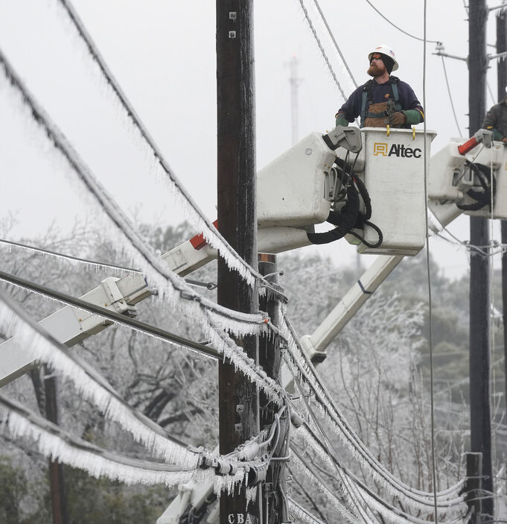
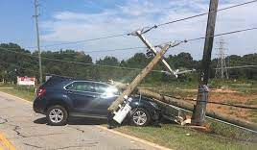
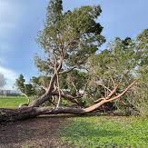
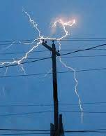
Common forms of power outages.

Slide 27
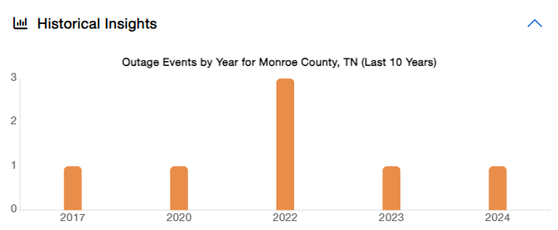
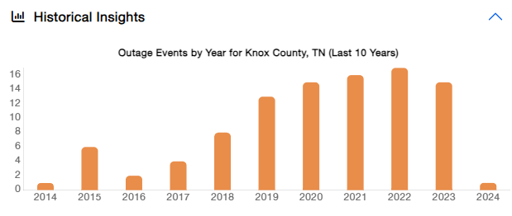

Slide 28
What are the risks of losing power?

Slide 29
Depends on how long of an outage and your individual needs.
Food held above 40 degrees for more than 2 hours that should be discarded:
Raw or leftover cooked meat, poultry, fish, or seafood. Lunchmeats, hot dogs, bacon, sausage. Soft cheeses, milk, etc.…
People with medical equipment needs
Dialysis machines
Oxygen equipment
CPAP
Medications

Slide 30
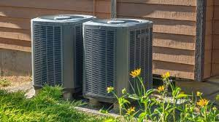
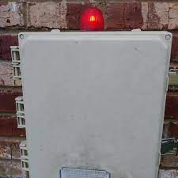
Home Appliances
Heating and Air
Sump Pump
Well Pump
Garage Door Opener
Security system
Grinder Pump

Slide 31
How can I be prepared?

Slide 32
Power outage tips?
Keep freezers and refrigerators closed.
Do not use a gas stove or oven to heat your home. (Carbon-monoxide poisoning)
Have alternate plans for refrigerating medicines or using power-dependent medical devices
Check with local officials about heating and cooling locations open near you.
Supply of food and water that does not require refrigeration

Slide 33
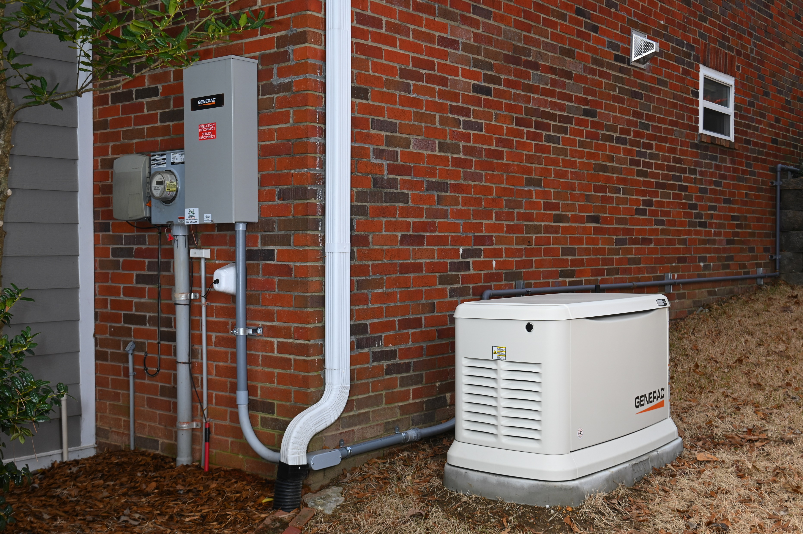
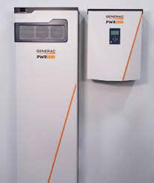
Alternative sources of power?
Solar Panels
Home-Standby Generator
Portable Generator
Battery Back-up

Slide 34
Thank you!
Any Questions?

Slide 36
Agenda – New Business
By-Laws change
Community Garden
Battery Energy Storage System (BESS) – Update
Lawsuit update
Radon Testing
911 Switch
www.rbhoo.org

Slide 37
RBHOO – By-Law
Modification to By-Laws
Unpaid Dues Current Wording
www.rbhoo.org

Slide 38
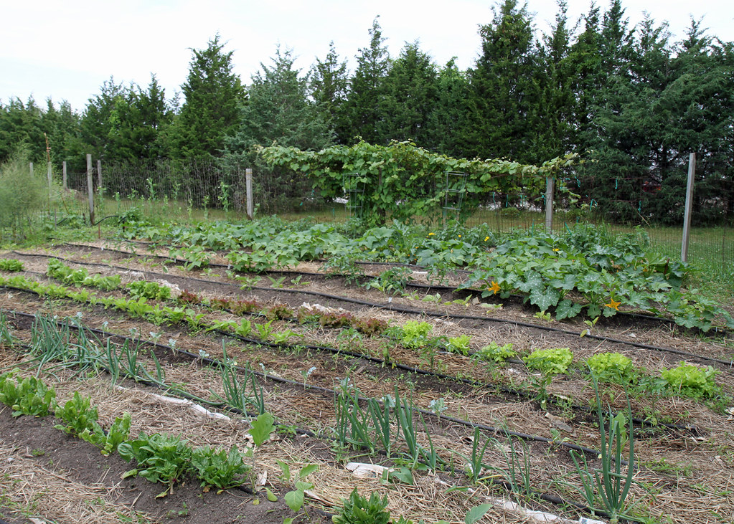
Rarity Bay Club – Community Garden
POC – Ron Walker/Rick Hoban
www.rbhoo.org

Slide 39
Rarity Bay Club – Community Garden
Open to All RB Residents
First Come/First Reserved Plots
Attempt to Accommodate Plot Size Requested
(e.g., 10’x10’; 20’x20’; 40’x40’; larger if requested)
Request What You Want
Please use what you request to accommodate as many gardeners as possible
2023 Growing Season - 24 Gardeners (decrease from previous years)
Costs - $10 (Personal Check)
Goes into Operating Budget for Common Expenses
(e.g., equipment repairs/parts; fire ant killer; rodent repellant)
Cost to plow, disk & turn and till the soil at beginning of growing season
Use of community tillers/plows; provide your own oil & fuel;
check prior to each use; top off fuel when done
Each gardener supplies own hoes, rakes, hoses/sprinklers, fertilizer, seeds/plant materials, cages/fencing
Water is free - Golf Course feed (part of SPC Services agreement)
www.rbhoo.org

Slide 40
Rarity Bay Club – Community Garden
Gardeners Encouraged to Donate Excess Produce to Weekly Market
Community Bin for Donations Located About Middle of Garden Area (Partridge Drive)
Excess Produce Donated to Meals on Wheels & Cora Veale Senior Center
Shoppers Are Encouraged to Donate Appropriately
Managed by Yolanda Sorenson/Mary Ann Cole
Free Consulting from Veteran Gardeners
Worth What You Pay for Same - ☺
Ladies Use Excess Plots for Flower Garden
Normally at west end near Dog Park/RB Parkway
www.rbhoo.org

Slide 41
Rarity Bay Club – Community Garden
Key Dates
Initial Call for Gardeners went out last week. (Community Newsletter & Email)
Garden has been plowed and turned
Rototilling will be done once the ground dries out
Finalize Plots & Roster & Place Placards at Front of Plots o/a 1 April
Weekly Community Garden Market on Wednesdays Starting o/a July 4th
National First Planting Date on or about 15 April
After Last Likely Frost
End of Growing Season Normally After Labor Day
Post Season Harvest Potluck Dinner for All Gardeners – Sep/Oct TBA
BYOD (Dish to Share)/BYOB
Post Season Clean-up Around Holidays
Kudos to Key Players
Questions/Comments
www.rbhoo.org

Slide 42
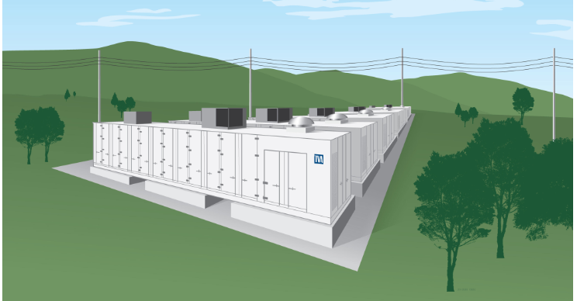
Community/Outreach Presentation
Tennessee Valley Authority – Battery Energy Storage System
TVA will be at our March 13, 2024, RBHOO meeting.
No update on Emergency Preparedness Plan
No update on funding for 2nd egress from Rarity Bay
www.rbhoo.org

Slide 43
Lawsuit Update
Declarant Lawsuit
Judge denied SPC’s Motion for Summary Judgement
Hugh win for the community!
www.rbhoo.org

Slide 44
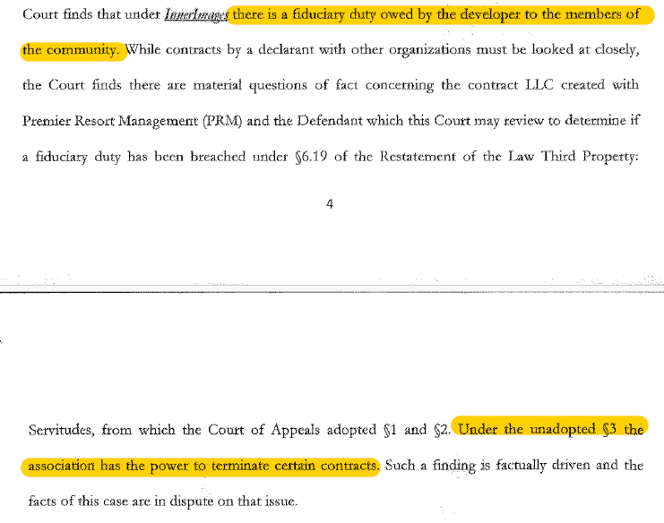
Lawsuit Update
www.rbhoo.org

Slide 45
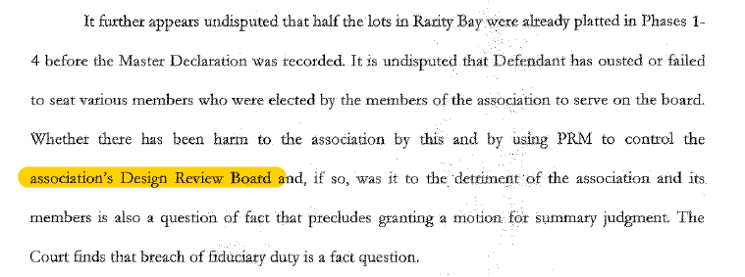
Lawsuit Update
www.rbhoo.org

Slide 46
Lawsuit Update
Other Lawsuits
Assessments 20-489 March 27 and 28 (April 8 if needed)
Election 21-173 March 27 and 28 (April 8 if needed)
Partnership 19-943 Heard on December 4,5,6,7 & 8
No Update
www.rbhoo.org

Slide 47
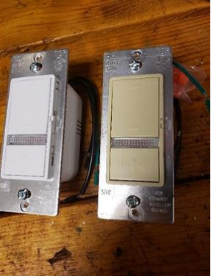
Rarity Bay Club – Activities
Radon Test Kits
RBHOO has 3 test kits for residents to borrow
Simple to use
See Rick Hoban
911 Switch
RBHOO has them for sale $30
www.rbhoo.org

Slide 48
Membership
Membership
Current - 183
2024 Goal – 200+
Households
www.rbhoo.org

Slide 49
Upcoming Events
RBHOO Regular Meetings
March 13
Education Presentation Reserved for TVA
Outreach Presentation - Rodney Grugin, President of the Loudon County Chamber of Commerce
Rarity Bay Club – N/A
Activity Spotlight – Yellow Dot and House Buddies
April 14
Education Presentation –
Outreach Presentation –
Rarity Bay Club –
Activity Spotlight –
Upcoming Events
February
27 – Last day of early voting in Monroe/Loudon County
March
5 – Presidential Preference Primary and County Primary Election
10 – Daylight Savings Time Starts
April
26 – Rarity Bay 30th Anniversary Celebration
May
18 - Member Appreciation Picnic
June
Golf cart movie night
August
1 - State and Federal Primary and State and County General Election
October
9 – RBHOO Meet the Candidates
November
3 – Daylight Savings Time Ends
5 – State and Federal General Election
16 - Chili Cookoff
December
11 – Christmas Party
www.rbhoo.org

Slide 50
Questions
www.rbhoo.org

